Slide 1
Capstone Report: Predict Accident Severity
Lorena Wang

Slide 2
Introduction
Road traffic injuries and deaths has been a global severe problem. According to the statistic report from World Health Organization (WHO):
Every year 1.35 million people are killed as a result of a road traffic crash.
Between 20 and 50 million people suffer non-fatal injuries, which most can lead to disabilities in their life.
Road traffic injuries are estimated to be the eighth leading cause of death globally for all age groups and the leading cause of death for children and young people aged 5–29 years old. More people now die in road traffic crashes than from HIV/AIDS.

Slide 3
Problem
Analyze the relationship in main factors and the traffic accidents severity.
Build models to predict the severity of the traffic accidents according to the factors in the car collision data in the city of Seattle, USA.
Future Application: This predictive model can be applied to multiple practical conditions to save life, such as safe route planning, emergency signal light control, vehicle allocation, signals placement or even AI car design.
Stakeholders: state and local government agencies, non-governmental organizations, regional authorities, AI technology companies, and even individuals.

Slide 4
Data Description
The car collision data is obtained from Seattle Govt’s website, which records the severity of the accident and the current factors, including road condition, light, speed, weather, etc.
Data Source http://data-seattlecitygis.opendata.arcgis.com/datasets/5b5c745e0f1f48e7a53acec63a0022ab_0/data
Data Cleaning:
INCDTTIME is transformed to date type and the Month, Weekday, Hour
Drop duplicate variables
Balance data for Predictive models

Slide 5
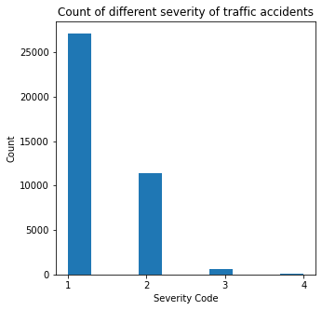
Exploratory Data Analysis
SEVERITYCODE | SEVERITYDESC
1 | Property Damage
2 | Injury
3 | Serious Injury
4 | Fatality

Slide 6
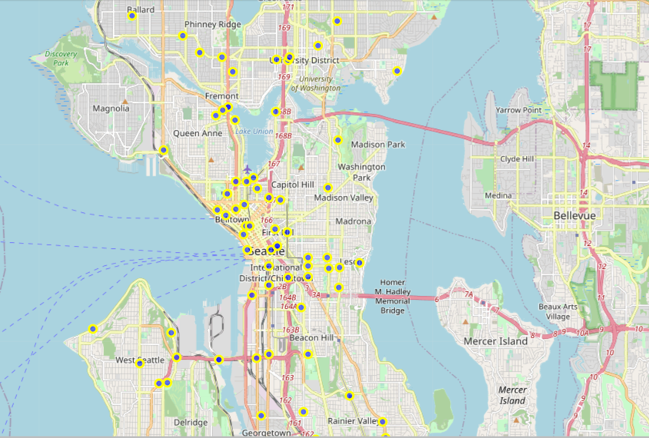
Seattle traffic collision map
The Python folium library is used to see the geographic details of the Seattle traffic collisions. In this step, 100 traffic accidents are selected randomly

Slide 7
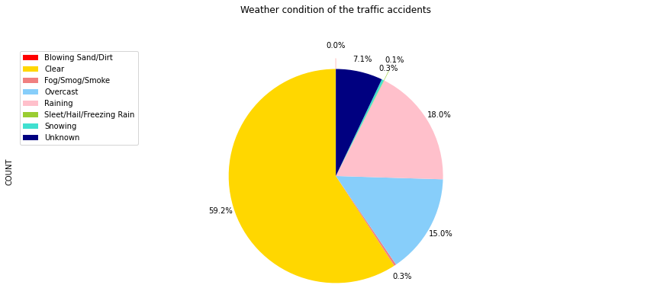
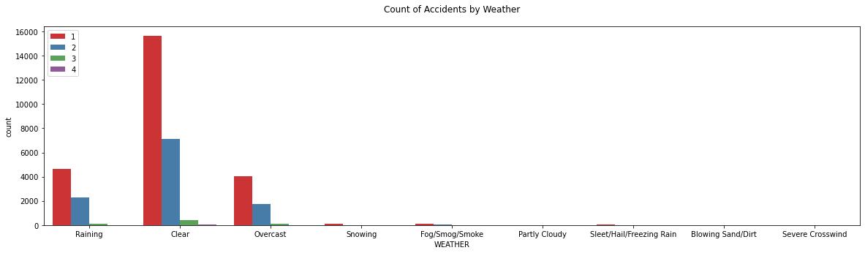
Weather in collisions
Majority: Clear (59.2%), while annual sunny day percentage in Seattle is 41.6%
Precipitation (18.4%), annual precipitation day percentage in Seattle is 42.5%
It’s amazing to see that the probability of a car accident happens on clear days is 17.6% higher than the annual probability of clear days, while the probability of a car accident happens on precipitation weather is only 43% of the annual precipitation probability.

Slide 8
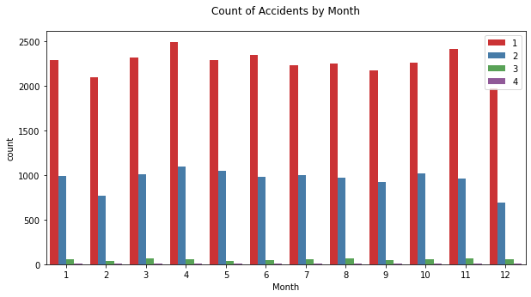
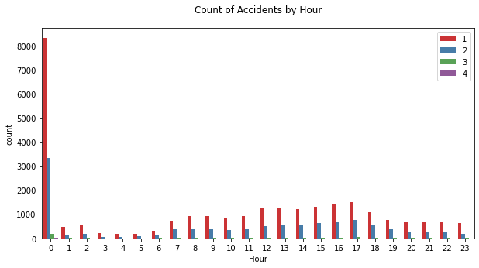
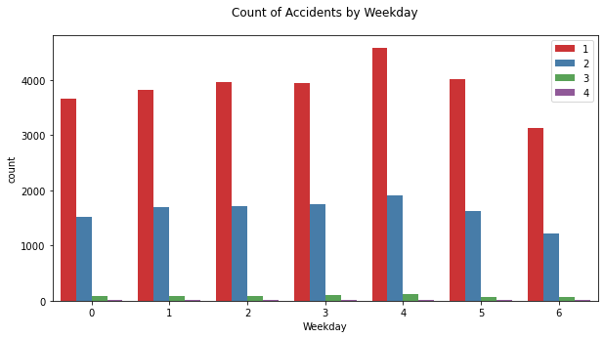
Count of collisions with Month, Weekday and Hour

Slide 9
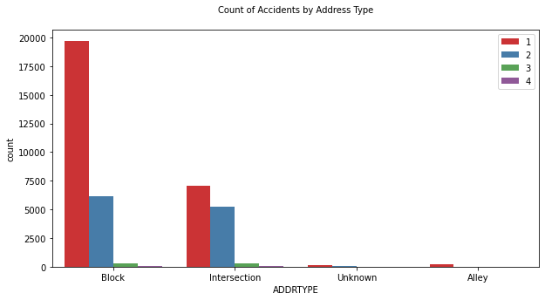
Count of traffic collisions by address type
Block type takes hold of 66.8% of the total traffic accidents, while Intersection and Alley counts for 32.2% and 0.53% separately.
Even though the 1-severity traffic accidents are much higher likely to occur in block address, the number of 2 and 3-severity traffic accidents are similar in intersection and block address.

Slide 10
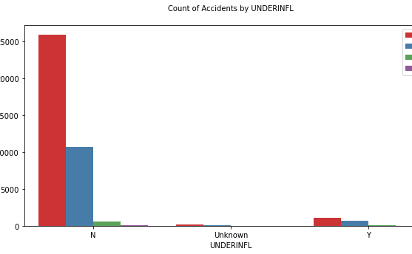
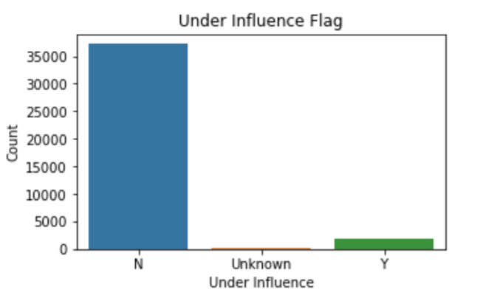
Count of traffic collisions by driver under influenced condition
Only 1% of the drivers involved was under the influence of drugs or alcohol in the total traffic collisions.
But around 17.3% of the drivers involved in the serious traffic collisions (except for 1-severity traffic collisions) were under the influence, which means the traffic accident with under influenced drivers are more likely to be a serious type.

Slide 11
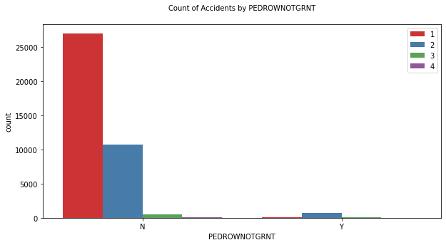
Count of traffic collisions by PEDROWNOTGRNT
There are 97.6% of the traffic accidents are in the condition with the pedestrian right of way granted in the total samples.
Ungranted the pedestrian right of way shows an extremely low rate in 1-severity type of traffic accidents, which means this condition can decrease the probability of traffic accidents, especially 1-severity type.

Slide 12
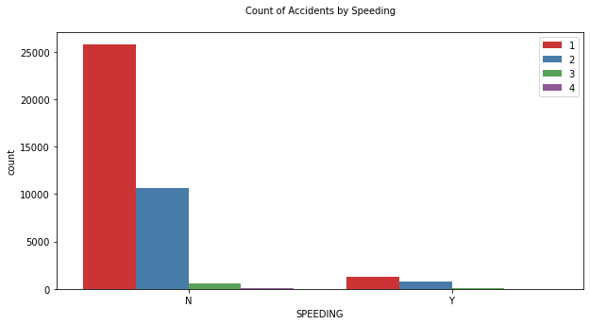
Count of traffic collisions by if caused by speeding factor
94.4% of the total traffic collision samples are not caused by the speeding factor.
The rate of serious type traffic collision samples (expect 1-severity type) caused by speeding factor is higher than the 1-severity type collision.

Slide 13
Predictive Modeling
In this project, classification machine learning algorithms are used to predict severity of the traffic collisions.
Logistic Regression, K Neighbors Nearest (KNN), SVM and Decision Tree algorithms are used to classify the traffic collisions into the initial four severity types and the transformed two classes. The accuracy of each algorithms is compared.
The top factors in the decision tree algorithm are visualized.

Slide 14
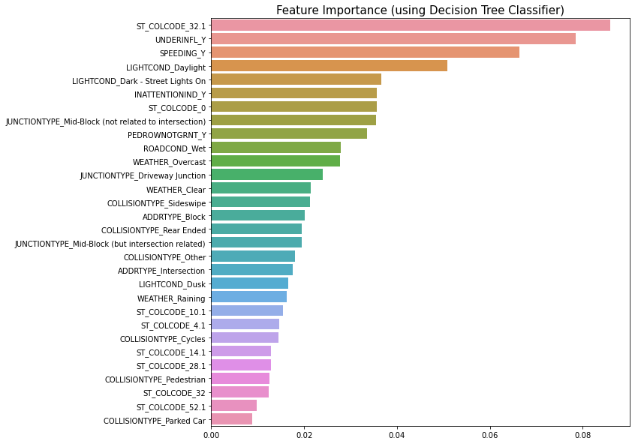
Multi-Class Predictive Model
Algorithm | Accuracy
LR | 56.23%
KNN(K=7) | 67.31%
SVM | 65.59%
Decision Tree | 70.83%
Severity/ f1-score | LR | KNN | SVM | Decision Tree
1 | 0.62 | 0.62 | 0.64 | 0.64
2 | 0.49 | 0.54 | 0.53 | 0.59
3 | 0.43 | 0.67 | 0.60 | 0.71
4 | 0.68 | 0.86 | 0.85 | 0.88

Slide 15
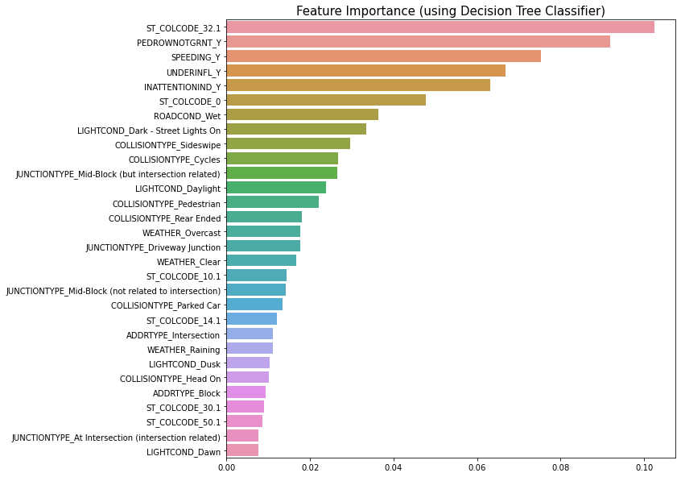
Two-Class Predictive Model
Algorithm | Accuracy
LR | 75.88%
KNN(K=7) | 81.15%
SVM | 78.56%
Decision Tree | 83.68%
Severity/ f1-score | LR | KNN | SVM | Decision Tree
0 | 0.77 | 0.80 | 0.79 | 0.83
1 | 0.75 | 0.82 | 0.77 | 0.84

Slide 16
Conclusion
This project analysed the relationship in main factors (weather, month, weekday, hour, address type, drivers’ condition, speeding and pedestrian right to way) and the severity of traffic collisions.
The predictive models are built in LR, KNN, SVM and Decision Tree algorithms. Besides the original severity code degree, this project also makes a two-class level severity code.
We can conclude that Decision Tree has the best predicting accuracy in Multiple-Class and Two-Class models, with 70.83% and 83.68% accuracy separately. The top factors in the decision tree algorithm are also visualized in this project.

